Slide 1
BUSINESS ANALYTICS COURSE:
FINAL PROJECT REPORT
Group B:
Ibnu Sulaiman
Erlanda Maulidia Sultana G.W
Indrayoga Putra
Andoni Fikri Oktaviano
Shalma Rizqi Kirana
Notes:
ibnu

Slide 2
Outline
Analysis Subject Definition
Analysis Design
Univariate & Bivariate
Data Processing
Analysis Execution
Result Evaluation and Solution Consideration
Summary (Proposed Solution for Selected Segment)
Notes:
ibnu

Slide 3
1. Analysis Subject Definition 1-1. Client Issue and Analysis Subject
We recognize that slow profit growth is a business challenge for Mail-Order Department. In this project, we will analyze the factors of response rate to implement the solution to increase the number of response rate.
Business Challenge (What)
Client Overview
Mail-Order Department of Retail Company
Conducted big campaign, but it didn’t work.
Problem
Slow profit growth.
Analysis Subject (Where)
Issue
It may occurred due to low conversion rate that caused by low response rate of campaign.
Solution
(Why,How)
Assumed Solution
By increasing the response rate, it’s expected to raise the conversion rate that would impact to the higher profit growth.
Notes:
Ibnu

Slide 4
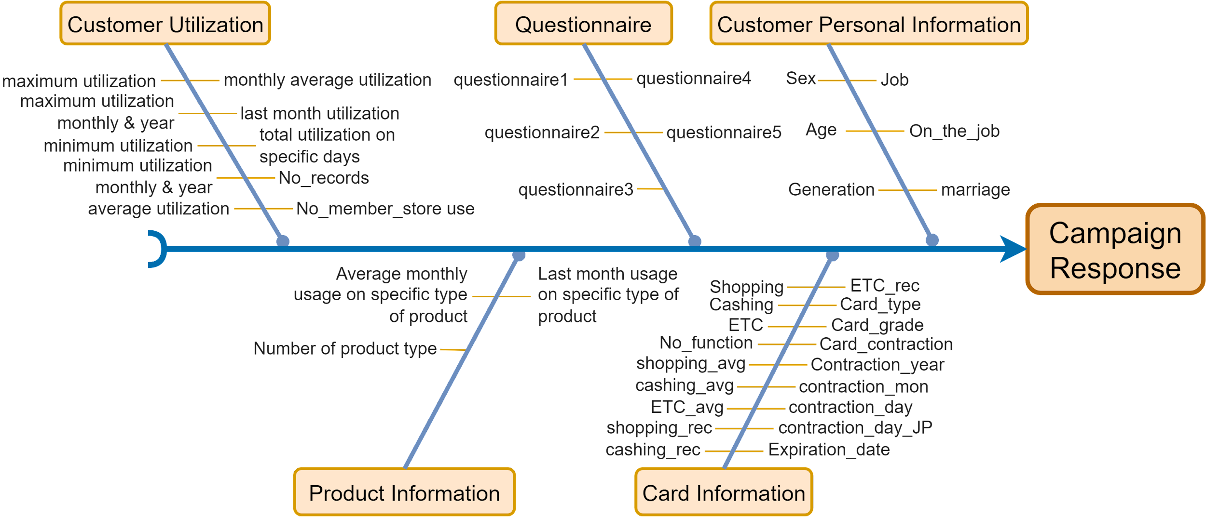
1. Analysis Subject Definition 1-2. Used Data and Objective Variable: Response
This project use the data given from Mr. Matsui, the general manager of Mail-Order department that we received and analyze the causes of low response rate to get effective measures for solution proposals.
Business outcomes (CR/Sales)
Relevant metric → campaign effectiveness
Provide CB insight → optimization (retargeting)
Notes:
These data are linked to the campaign response, which is our objective variable, to generate the business outcomes such as conversion rate or sales. Also, it’s a relevant metric to evaluate the effectiveness of the campaign. It provides the insight to customer behavior that can help to identify the area for optimization such as retargeting customer.

Slide 5
2. Analysis Design
We proceeded the project with following approach.
Data Collection
Data Study and Variable Selection
Analysis Exec.
Result Eva.
Analysis Step
Data Confirmation
Univariate Analysis
Bivariate Analysis
Data Processing
Variable Selection
Multivariate Analysis
Solution Consideration
Notes:
Ibnu; Persingkat kalimat ; diagram saja, detail di bawah sudah appendix

Slide 6
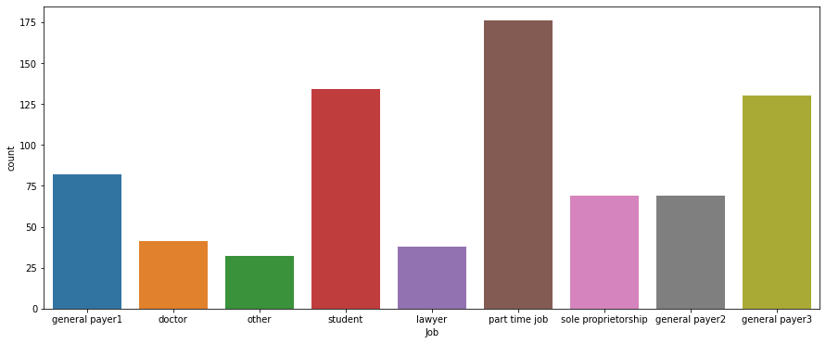
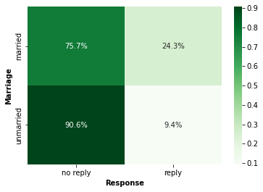
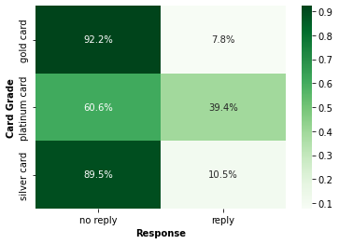
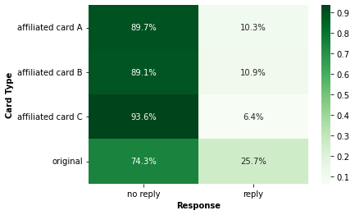
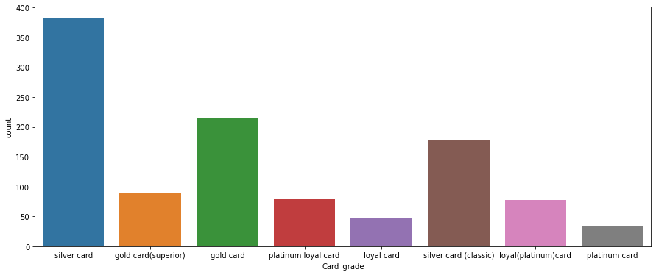
3. Univariate & Bivariate
We found some naming inconsistency at some part of the data after we conduct univariate analysis.
By doing some statistical test, there are 3 feature that is strongly related with the target variable.
Notes:
doni

Slide 7
4. Data Processing
Data Transformation
Drop Columns
Fill Null Value
Transform usage and charge columns into three category
Drop columns that doesn’t give clear decision tree analysis and null value> 60%
Fill null value with probability 50 % LOW, 50 % MED and mode
(min value, 25 th percentile )
LOW
Column doesn’t give clear decision tree analysis
Fill null with 50 % LOW, 50% MED
(25 th percentile , 70 th percentile )
Date columns
Generations columns
No_records, No_member_store use
Null Value > 19 %
Usage columns
Charge columns
MID
75 th percentile , max value )
HIGH
Mapping a few category into one category
Column with null value > 60%
Fill null with mode
General payer 1,2,3
General payer
Null Value <8%
Marriage: unmarried
Shopping average: MED
Shopping rec: MED
Job: general payer
Onlineservice
food
General
network
onlineshopping
beauty
Amusement
Quetionnaire
Gold Card Superior
Gold Card
Silver Card Classic
Silver Card
Platinum and loyal card
Loyal (Platinum) Card
Notes:
Indra: 1menit 48 detik; 1 menit 39 detik , 1 menit 30 detik

Slide 8
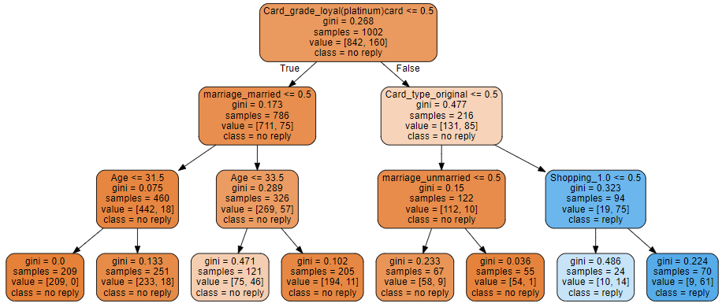
5. Analysis Execution ( Decision Tree Analysis )
We found three segment that have large population and majority of them no response to campaign
1
2
3
Notes:
Shalma; menjelaskan tiga buah branch dan memutuska untuk fokus ke segmen 1 saja karena semuanya no response

Slide 9
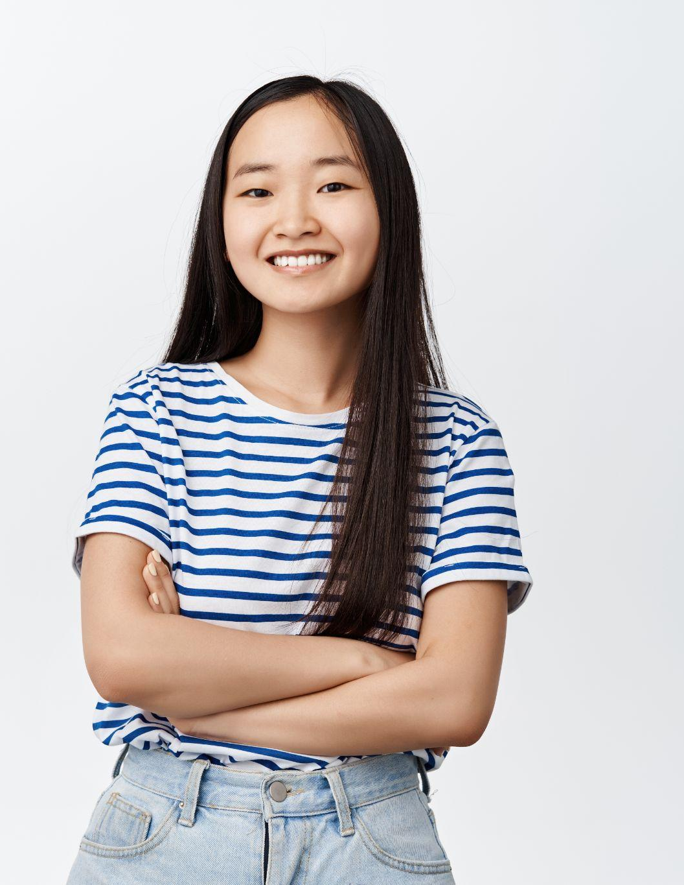


6. Result Evaluation and Solution Consideration
As Segment 1 has proven to be very interesting with a 100% no-response rate and large sample size, here are the evaluation and solution considerations (by looking at the issues) regarding this segment:
Persona: “Teenage Girl”
Market Research
Young Female (Ages 14-24)
High School to College Students
Low average monthly utilization (Have no income except from their parents)
Might be interested in trending/hype products with affordable price
What’s the issue (Gap)?
Unaffordable/Unreasonable price
Promotion platform not suitable
Product not right for the target market
Possible Solution?
Notes:
(saran tampilin yang paing menarik)Erland

Slide 10
7. Summary (Proposed Solution For Selected Segment)
From the three segments, we propose to prioritize segment 1 ("Teenage Girl”) as our main focus with the following possible solutions:
Change product into trending/hype fashion & beauty products
Change to affordable price and express discount benefits
Promote through social media marketing (Instagram and TikTok) and influencer marketing
Innovate with natural ingredients for beauty-related product (soy milk, green tea, etc)
Notes:
erland

Slide 11
End

Slide 12
Appendix

Slide 13
Appendix 1. Analysis Design
Analysis Step
Data Collection
Data Study and Variable Selection
Analysis Exec.
Result Eva.
Data Confirmation
Univariate Analysis
Bivariate Analysis
Data Processing
Variable Selection
Multivariate Analysis
Solution Consideration
Calculate the basic statistic for each variable and examine the distribution.
Choosing significant feature for Multivariate Analysis based on statistical test
Find out correlation between each feature and target variable.
Handling all data to be processed for modelling.
Understanding the data
Fitting the data into Decision Tree Model
4P Analysis and Gap Analysis
Activity
Data type of each column
2. Meaning of Each Column
Missing value ratio
Data distribution
Data Inconsistency
Significant Feature
Redundant Feature
Categorical to Numerical
Fill the missing values
Creating New Variable
Decision Tree Visualization (Segment)
-
Solution for Chosen Segment
Output

Slide 14
Appendix 2. Segment 1 Biodata: “Teenage Girl”
Analysis Result
Persona
Card grade: silver card or gold card
Age: 31 or less
Unmarried
Young Female
Ages 14-24
Students (High School to College Students)
Low average monthly utilization (Have no income except from their parents)
Might be interested in trending/hype products with affordable price

Slide 15
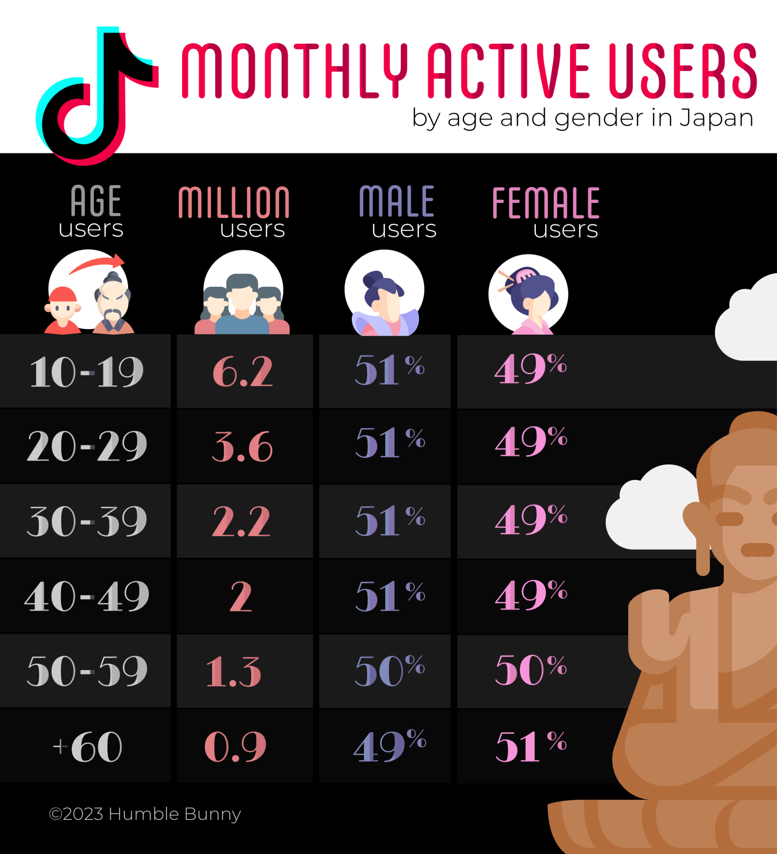
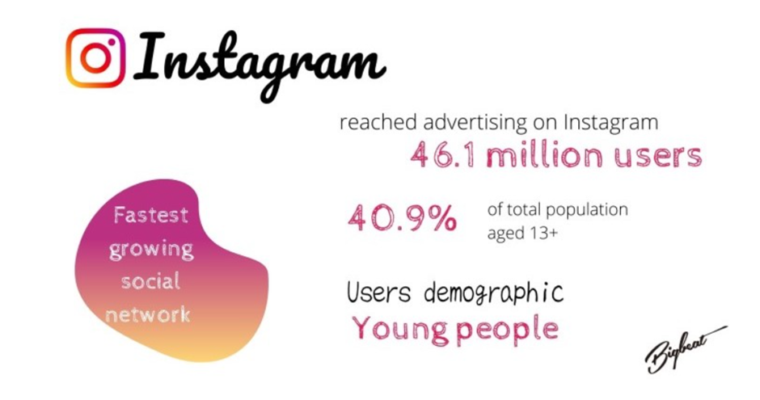
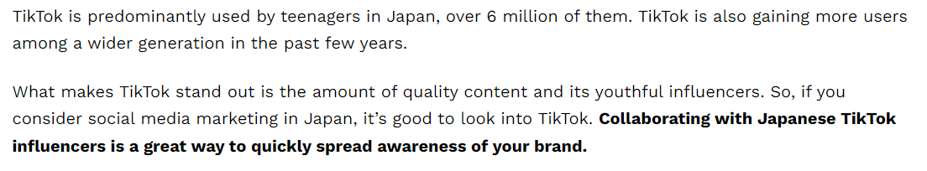
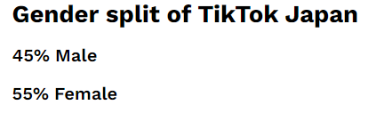
Appendix 3. Market Research for Segment 1: “Teenage Girl”
Social Media

Slide 16
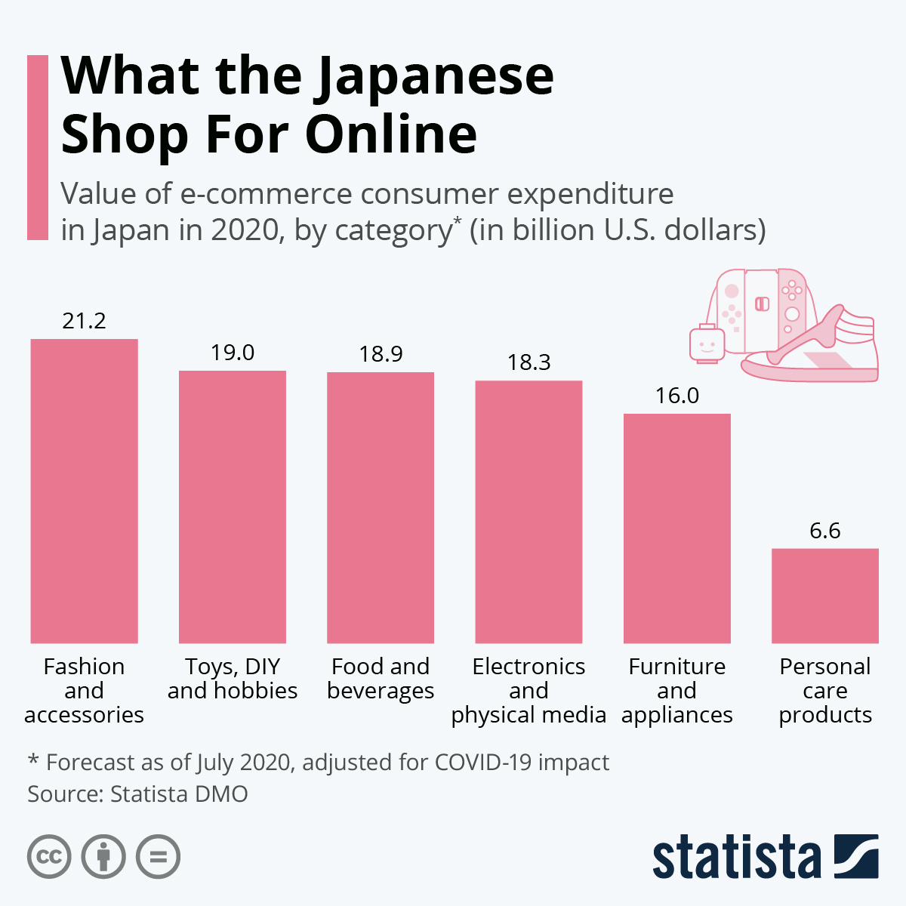
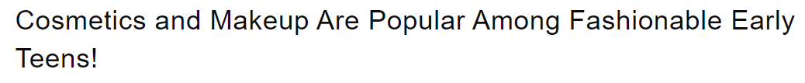
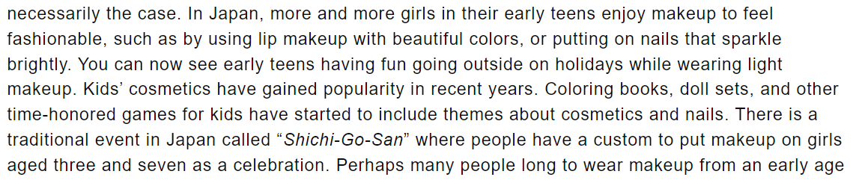
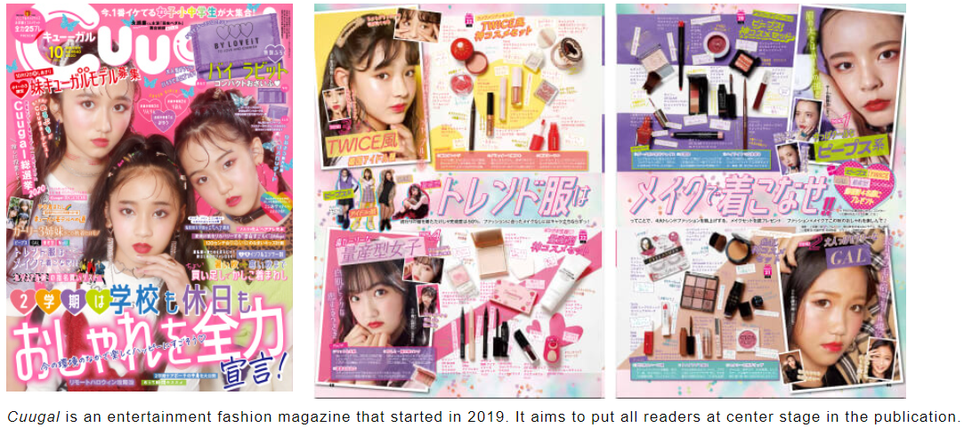
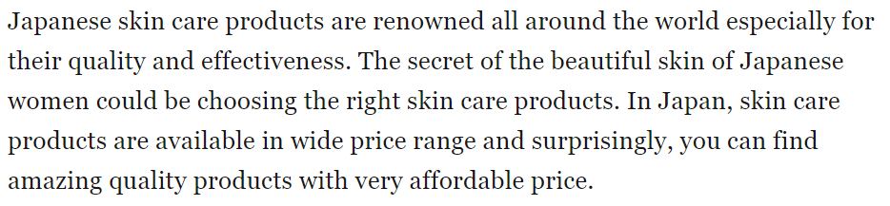
Appendix 4. Market Research for Segment 1: “Teenage Girl”
Products
Teen cosmetics trends on magazine

Slide 17
Appendix 5. Possible Solution for Segment 1: “Teenage Girl”
 | Current Situation (As is) | Ideal Situation (To be) | Issue (Gap) | Solution (To do)
Price | Large discount (Around 70%) | Reasonable price, Express Discount | Unaffordable price | Change to affordable price and express the discount (“buy one get one”)
Place (Target) | All customer | Teenage Girl Female Ages 14-24 | - | -
Promotion | Direct Mail (DM) | Social Media (Instagram and TikTok) | Not for Teenage Girl | Collab with young influencers Create an interesting and informative Social Media page Share real customer testimonials
Product | Electric appliances | Trending fashion & beauty products | Prefer to use products many people now used | Change the product to the trending/hype fashion & beauty products

Slide 18

Appendix 6. Segment 2 Biodata : “Men Executive Leader”
Analysis Result
Persona
Card grade: silver card or gold card
Age: 31 or more
Unmarried
Mostly senior age (above 30) -> might indicates mid-level to senior level professional
Adult Male
Office Worker
Unmarried
Medium to High Average Monthly Utilization -> Might be loving high end stuff and other luxurious experience
Mostly used their card for shopping purposes
Probably interested in luxurious experience.

Slide 19
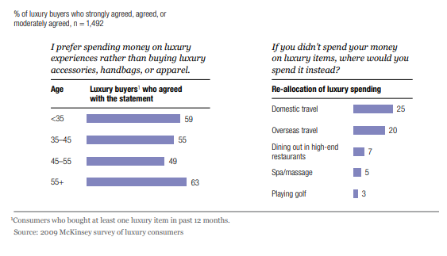
Appendix 7. Market Research for Segment 2: “Men Executive Leader”
What is the common behaviour of Japanese Luxurious goods buyer across the year?
Japanese luxury consumers today weigh the purchase of luxury goods against luxury experiences, such as a vacation, a meal at an expensive restaurant, or a day at a spa.
Across demographic groups, almost half of the survey respondents said that they would rather spend money on such experiences than on luxury handbags, accessories, or apparel (Exhibit 3).
Japan’s Luxury Shoppers Move On, McKinsey&Co

Slide 20
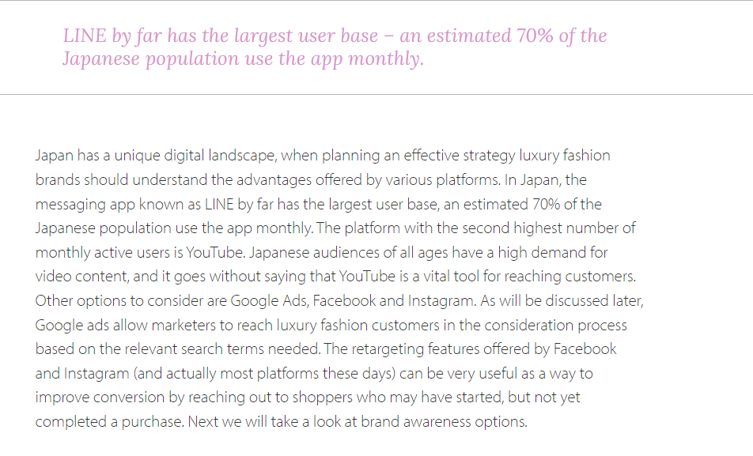
Appendix 8. Market Research for Segment 2: “Men Executive Leader”
Line has become the mostly used digital platform in Japan
Youtube is the second largest social media platform in Japan after Line for promoting luxurious brands.
Although the ease of use of social media, the luxurious brands still need to reach out the customer for increasing the brand awareness.
How is the Japanese Luxury Fashion Market Being Impacted by Digital Marketing Trends, humblebunny

Slide 21
Appendix 9. Possible Solution for Segment 2: “Men Executive Leader”
 | Current Situation (As is) | Ideal Situation (To be) | Issue (Gap) | Solution (To do)
Price | Large Discount (Around 70%) | Competitive Pricing | Unaffordable prices compared to competitor | Create a competitive pricing
Place (Target) | All Customer | “Men Executive Leader” Male 30s - 40s | - | -
Promotion | Direct Mail (DM) | Personal Message Platform Line, Youtube | Executives are using the platform for work purposes not for spending activities | Promoting with popular social media like Line or Youtube. Utilize top level sales person from our company using message/phone call via Line.
Product | Electric Appliances | Luxurious Experience | Might be interested in luxurious experience | Offer luxurious experience (Overseas travel, spa/massage, and golf card voucher)

Slide 22

Appendix 10. Segment 4 Biodata: “Prime Professionals Savvy Wives”
Analysis Result
Persona
Card grade: silver card or gold card
Age: 33 or more
Already married
Many in the 30s
Adult Female
Office Worker
Already married
Medium Average Monthly Utilization -> Might be budget-conscious, responsible credit card users, and knowledgeable in managing money
Might be interested in rewards programs or other benefits that can provide additional value for their spending

Slide 23
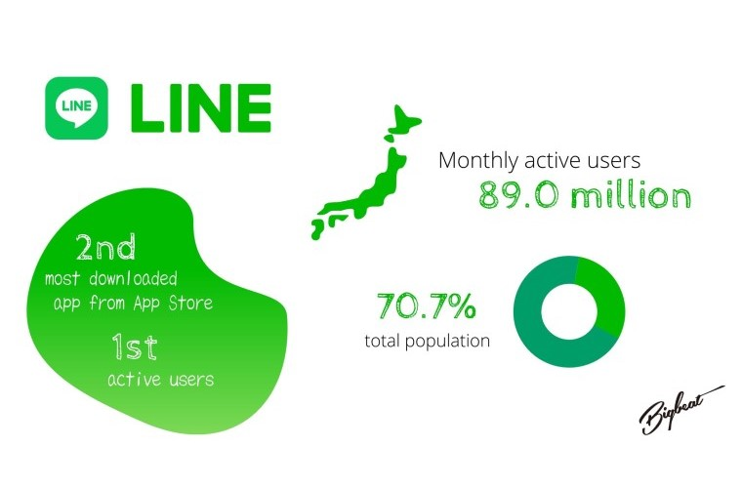
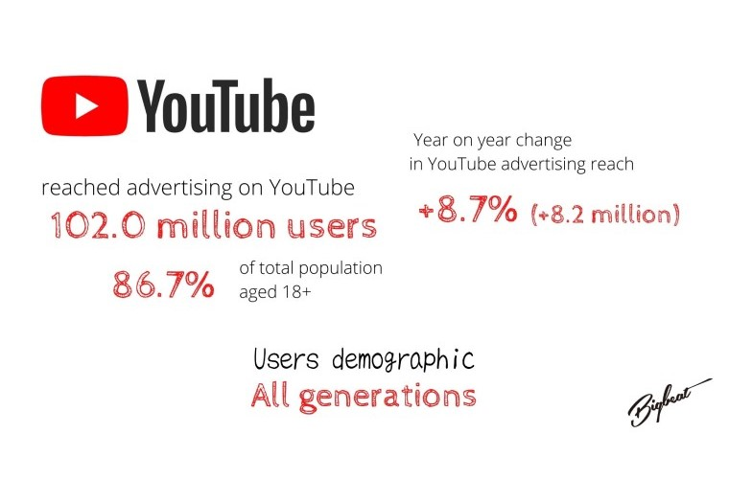
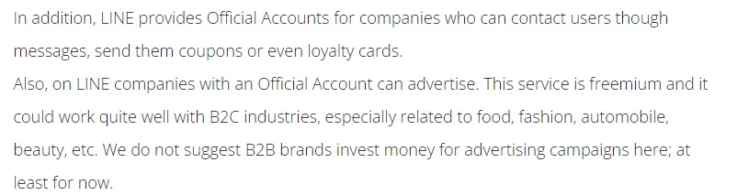
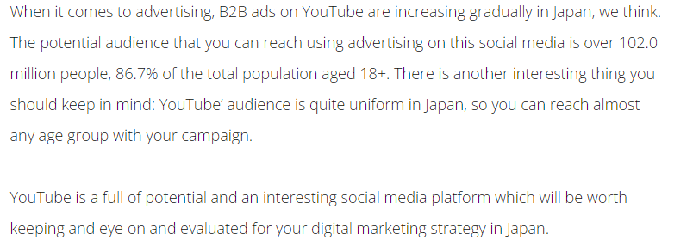
Appendix 11. Market Research for Segment 4: “Prime Professionals Savvy Wives”
Line is the 2nd most downloaded and the number one social media in Japan. Suitable for B2C purposes related with beauty, fashion, etc. Easy for companies to give loyalty benefits towards customers.
As Youtube demographic is suitable for all generations (and advertisement can be direct to specific target desired), it is one of the go-to option for digital marketing.
Source: https://www.bigbeatinc.com/blog/japan_social_media_2022

Slide 24
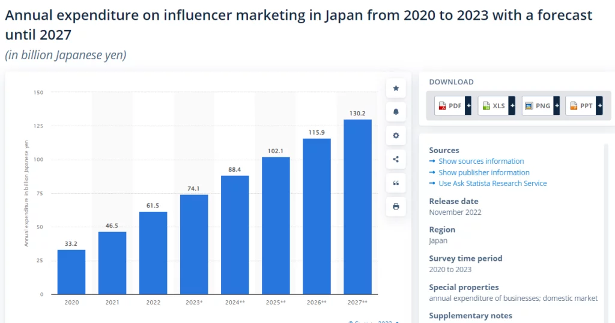
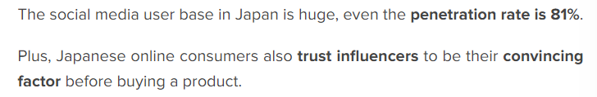
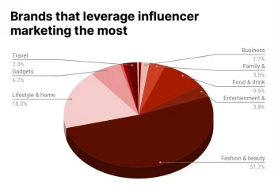
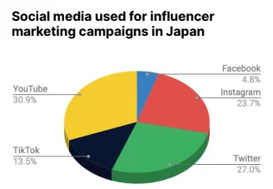
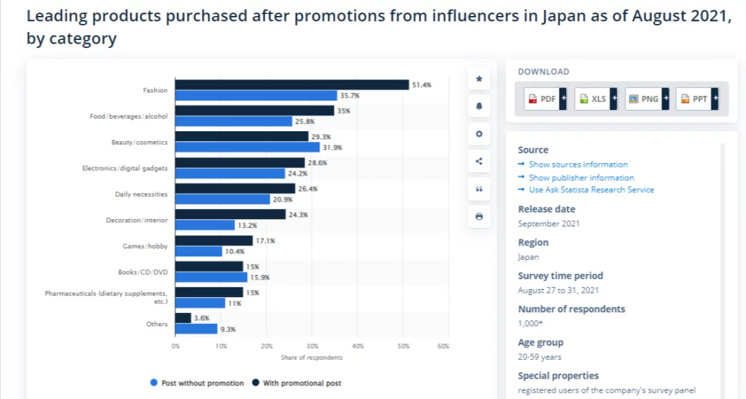
Appendix 12. Market Research for Segment 4: “Prime Professionals Savvy Wives”
What about Influencer Marketing?
According to the Influencer Marketing in Japan in 2023 – The willingness of brands to use influencer marketing rises each year as the trend of using social media rises.
The Japanese influencer marketing industry is still a bountiful ground to market products.
The more brands invest in influencer marketing, The higher the trust it gets.
Source: https://www.insg.co/en/influencer-marketing-japan/

Slide 25
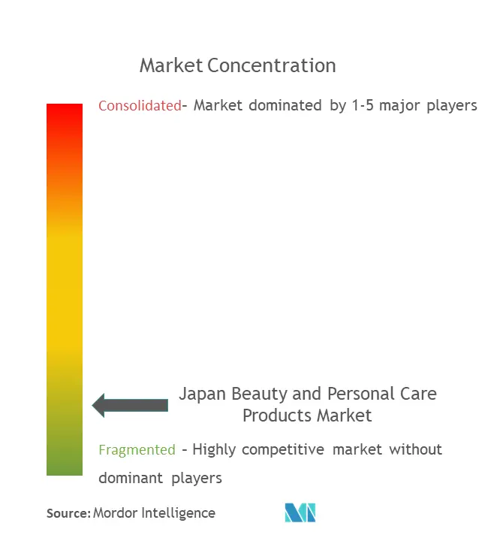
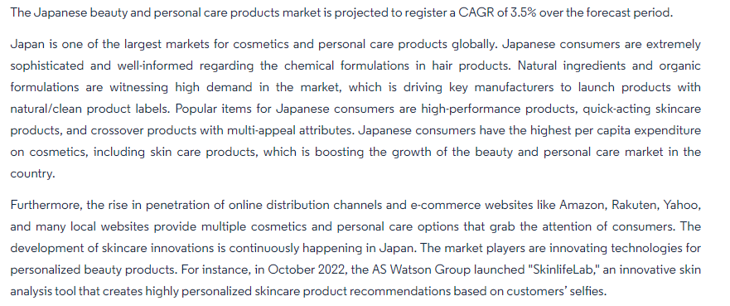
Appendix 13. Market Research for Segment 4: “Prime Professionals Savvy Wives”
Why Beauty and Personal Care Products?
A Fragmented Market (there is no one company that can exert enough influence to move the industry in a particular direction).
A rising demand for Natural Cosmetics and Skincare Products (there’s room for innovation)
Japanese have the highest expenditure on cosmetics products
Source:
https://www.mordorintelligence.com/industry-reports/japan-cosmetics-products-market-industry

Slide 26
Appendix 14. Possible Solution for Segment 4: “Prime Professionals Savvy Wives”
 | Current Situation (As is) | Ideal Situation (To be) | Issue (Gap) | Solution (To do)
Price | Large Discount (Around 70%) | Reasonable Price | Lack of Information | Provide necessary information
Place (Target) | All Customer | Professional Wives Female Age 20~Early 30s | - | -
Promotion | Direct Mail (DM) | Targeted social media ads influencer marketing | Use Mainly Mobile Devices, | Promote in social media platform in Line and Youtube Partnering with influencers
Product | Electric Appliances | Beauty/Personal Care Products with benefits for members | Might be interested in rewards/benefits (exp:discount, birthday gifts, etc.)) | Change the product into something that could bring added-value for their spendings

